Slide 1





final project
Connect Four
group 17
章顺杰，罗天辰

Slide 2
Contents
01
introduction
02
formulation
Gaming Background
Description of this game
Solution ideas &
comparative experiments
Results &
Contributions
03
04
The Algorithm To Solve This Problem
Summary this project

Slide 3
part one
introduction of Connect 4

Slide 4
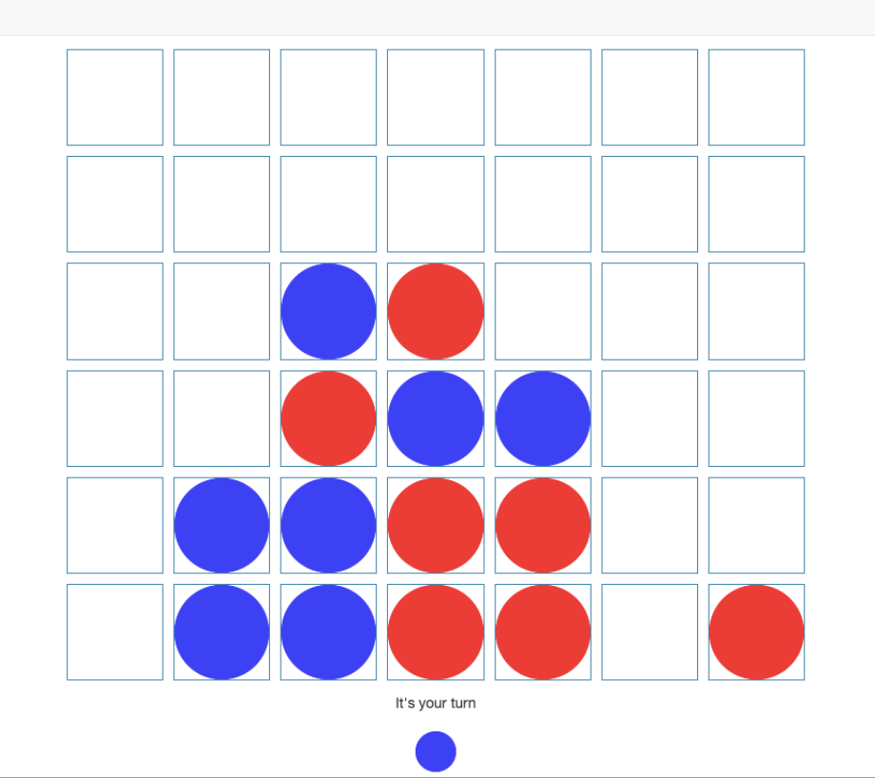
introduction of Connect 4
HOW TO PLAY IT
Connect 4 is a classic two-player strategy game played on a vertical 6x7 grid. Players take turns dropping colored discs into columns, where pieces descend to the lowest empty space. The goal is to be the first to align four of your discs consecutively—vertically, horizontally, or diagonally. Players must block opponents while advancing their own strategy. If the board fills completely without a four-in-a-row, the game ends in a draw.

Slide 5
part two
formulation

Slide 6
formulation
discription of this game
State: A 6×7 matrix with values {−1, 0, +1} representing player discs and empty slots.
Action Space: 7 discrete actions (column choices).
Reward: +1 for a win, −1 for a loss, 0 otherwise.
This formulation enables algorithmic implementations ranging from rule-based agents to deep reinforcement learning.
Terminal State ：
Win: A player forms a consecutive line of four discs horizontally, vertically, or diagonally.
Draw: The board is completely filled with no four-in-a-row for either player.

Slide 7
part three
Solution ideas and
comparative experiments

Slide 8
Solution ideas
Random Policy
Greedy Algorithm
Minimax
Q-learning (DQN)
The random policy selects moves uniformly from legal columns, offering no strategic advantage.
This heuristic-based approach prioritizes immediate gains (e.g., completing a 3-in-a-row) or blocking opponents.
Combining Minimax search with pruning, it evaluates future moves up to a fixed depth (e.g., 4 layers).
A reinforcement learning method training a neural network to predict optimal moves.

Slide 9



comparative experiments
AI vs AI
Let our AI agent compete with other existing AI agents, and calculate the winning rate.
AI vs Human
Fewer steps
Play with the AI agent and calculate the winning rate within the limited period of time.
See if our AI agent can beat us in fewer steps than other AI agent.

Slide 10
Adding more rules
According to some existing experiments on the ConnectFour game, there exists some strategy that will definitely if the board is small, while it’s easy to draw if the board is large, which is not fit for training AI.
Team combat
Calculate connected components
Instead of only judging on whether there is a connect four, we can count other connected components, such as ConnectThree or ConnectTwo, and re-evaluate the outcomes.
Let 4 agents participate in the game and each 2 of them can be viewed as a team. The final score is the sum of scores of each member, and the team with higher score wins.

Slide 11
part four
Core Project Contributions

Slide 12

Core Project Contributions
1. The existing AI algorithm is mainly minimax algorithm focusing on the 6 * 7 board game, which has already trained out a literally smartest AI, While this may not be as efficient when facing a larger game board. Our project tries to find out whether other methods can achieve an unexpected outcomes in a larger game board with different rules and more players.
2.

Slide 13
Thank you
QUESTION & ANSWER
group 17
章顺杰，罗天辰

